Slide 1
Continuous Integration and Deployment in Data Engineering

Slide 2
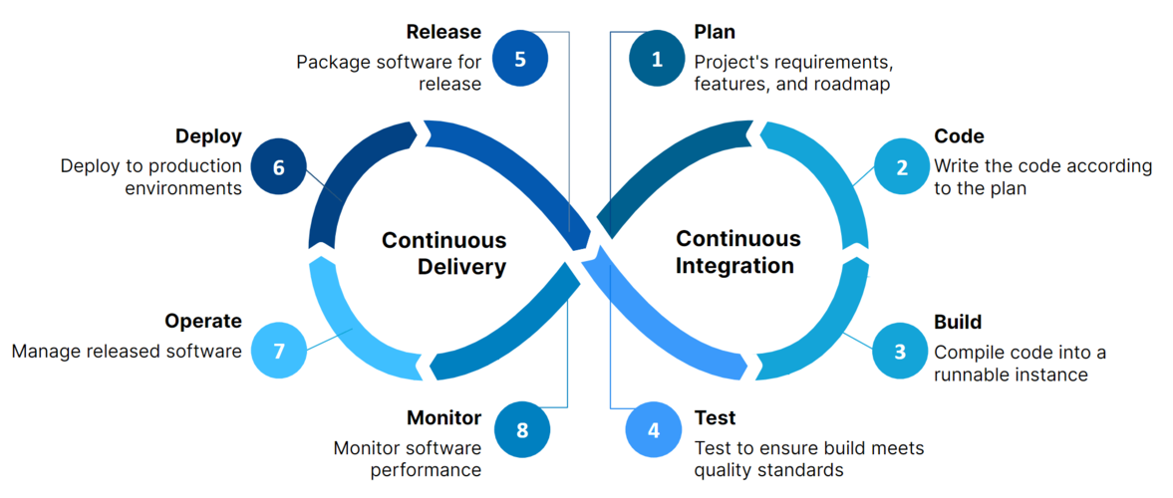
CI/CD
Stands for continuous integration and continuous delivery/deployment, aims to streamline and accelerate the software development lifecycle.

Slide 3
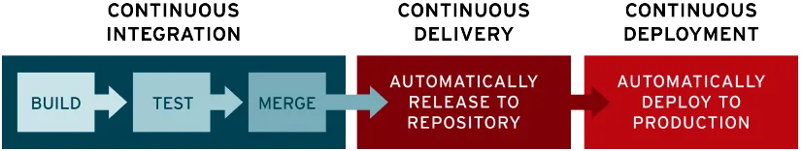
Continuous integration (CI)
Continuous integration (CI) refers to the practice of automatically and frequently integrating code changes into a shared source code repository.

Slide 4
Continuous delivery and/or deployment (CD)
Continuous delivery and/or deployment (CD) is a 2 part process that refers to the integration, testing, and delivery of code changes. Continuous delivery stops short of automatic production deployment, while continuous deployment automatically releases the updates into the production environment.

Slide 5
Why is CI/CD important?
Reduces bugs and code failures
Supports continuous development and updates
Simplifies complex applications
Improves efficiency and consistency
Minimizes downtime
Speeds up delivery
Enhances user feedback integration
Drives better customer outcomes

Slide 6
Why are CI/CD crucial for Data Engineering?
Enhanced Team Collaboration
Streamlined Code Integration
Consistent Deployments
Quicker Iterations & Improvements
Reduced Risk of Errors and Downtime
Supports building robust, reliable, and scalable data pipelines

Slide 7
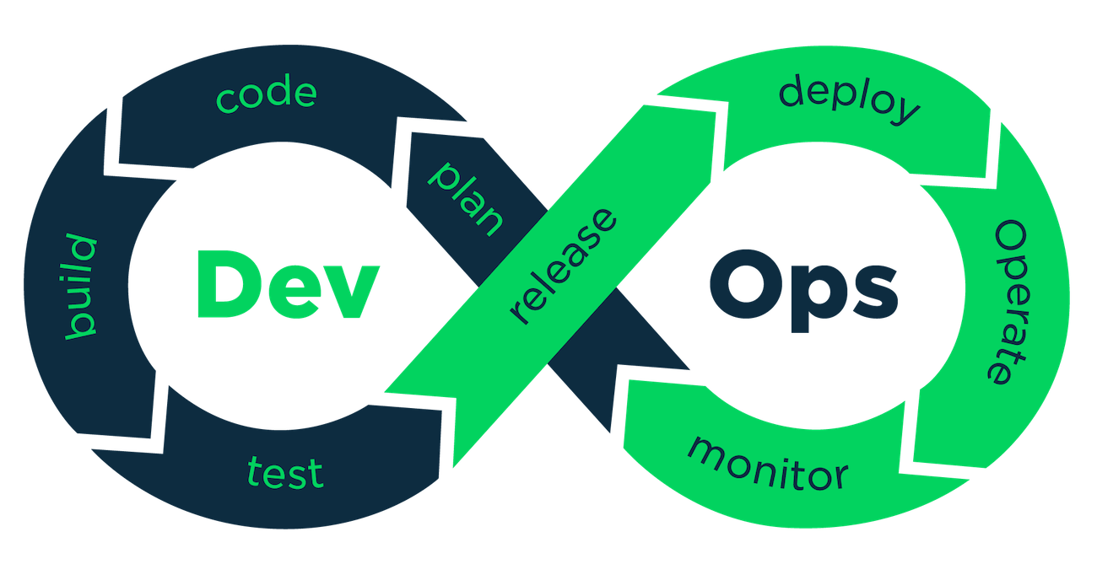
What is DevOps?
DevOps, short for Development and Operations, is the combination of cultural philosophies, practices, and tools that increases an organization’s ability to deliver applications and services at high velocity: evolving and improving products at a faster pace than organizations using traditional software development and infrastructure management processes. This speed enables organizations to better serve their customers and compete more effectively in the market.

Slide 8
CI/CD Vs. DevOps
CI/CD is an essential part of DevOps methodology, which aims to foster collaboration between development and operations teams. Both CI/CD and DevOps focus on automating processes of code integration, thereby speeding up the processes by which an idea (like a new feature, a request for enhancement, or a bug fix) goes from development to deployment in a production environment where it can provide value to the user.

Slide 9
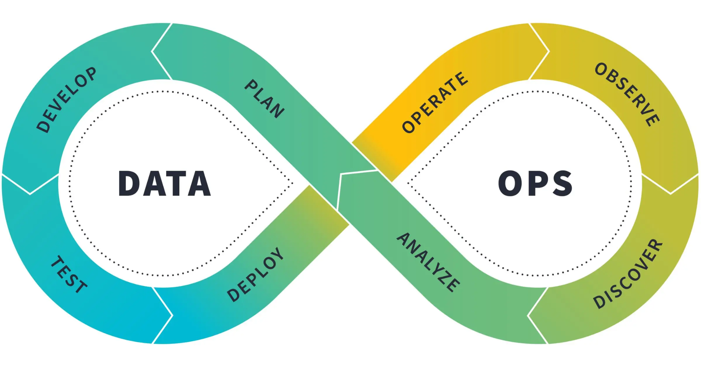
What is DataOps?
Like DevOps, which inspired it, DataOps follows a similar approach of integrating Data —data acquisition, transformation, and deployment of new changes—with Operation— observation, metrics and logging, and discovery and analysis.
Releasing new data products means merging and transforming data, usually from multiple sources. So, as in DevOps, DataOps uses version control to track changes to data transformation code and CI/CD automation to ship these changes to production.

Slide 10
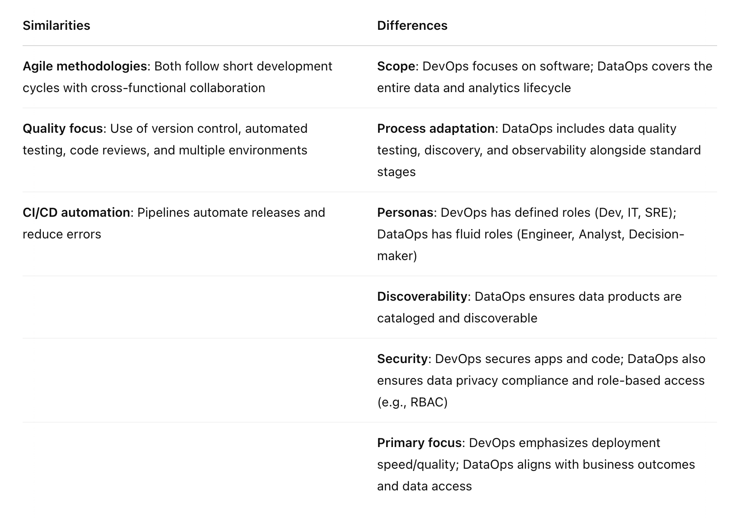
DevOps Vs. DataOps

Slide 11
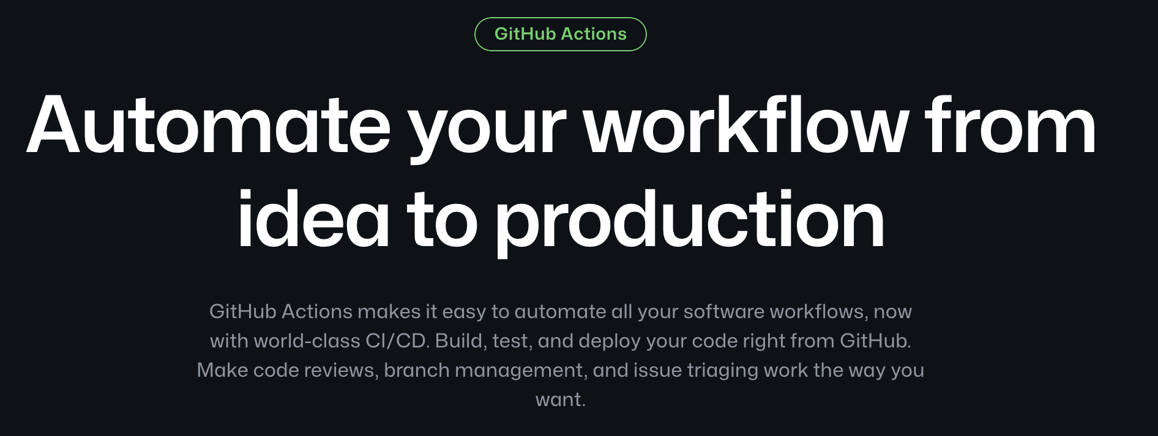
GitHub Action

Slide 12
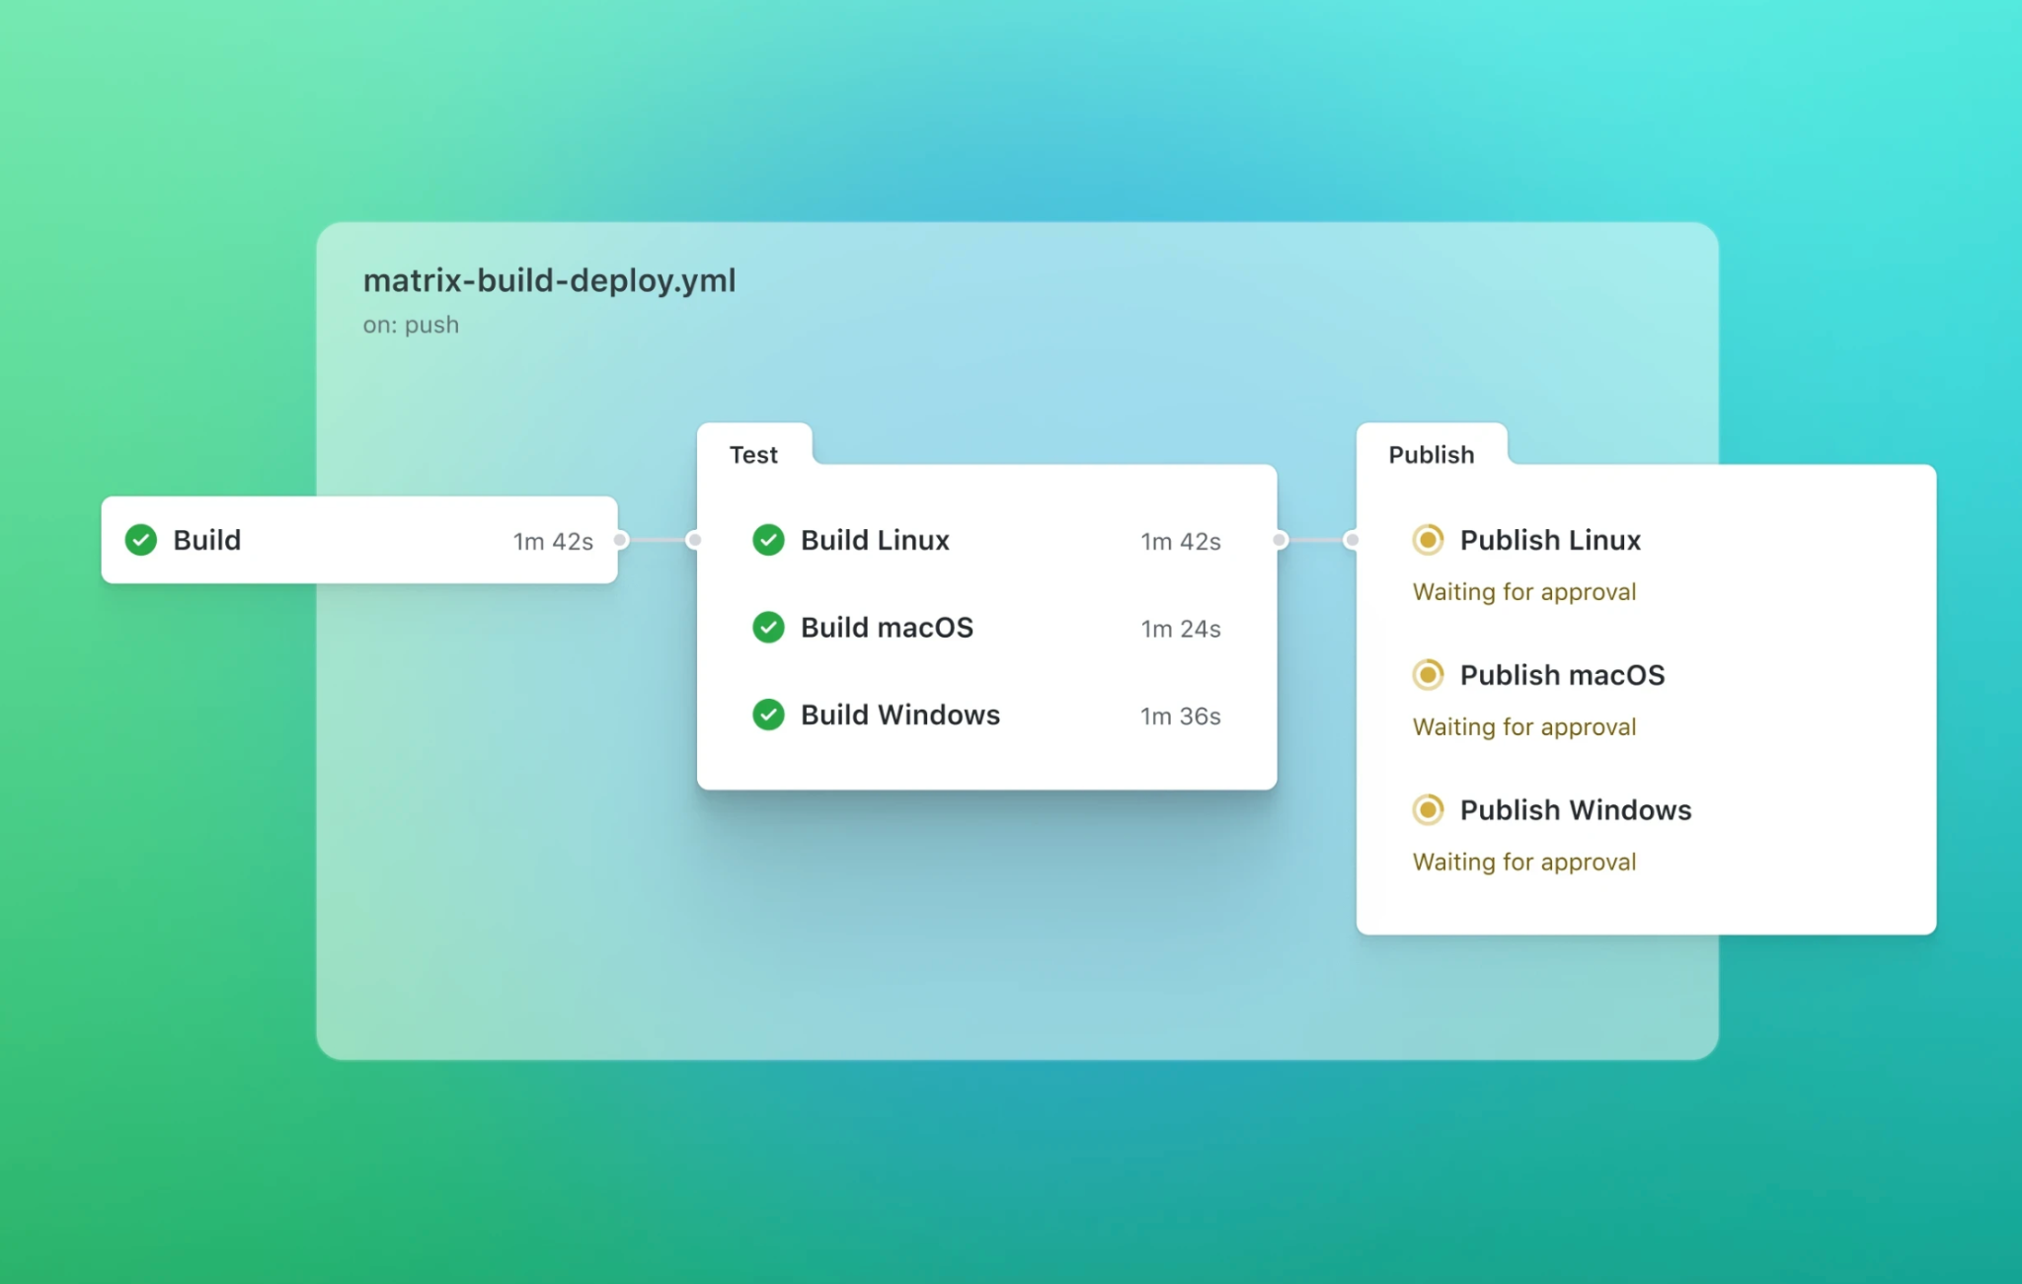
When code is pushed

Slide 13
Thank you

